Slide 1
PROJECT : 1
Project 1:
DC motor speed control
{PID simulation}

Slide 2
PID controller
Recall from the Introduction: PID Controller Design page, adding an integral term will eliminate the steady-state error to a step reference and a derivative term will often reduce the overshoot. Let's try a PID controller with small and . Modify your m-file so that the lines defining your control are as follows. Running this new m-file gives you the plot shown below.
Kp = 75; Ki = 1; Kd = 1; C = pid(Kp,Ki,Kd); sys_cl = feedback(C*P_motor,1); step(sys_cl,[0:1:200]) title('PID Control with Small Ki and Small Kd')

Slide 3
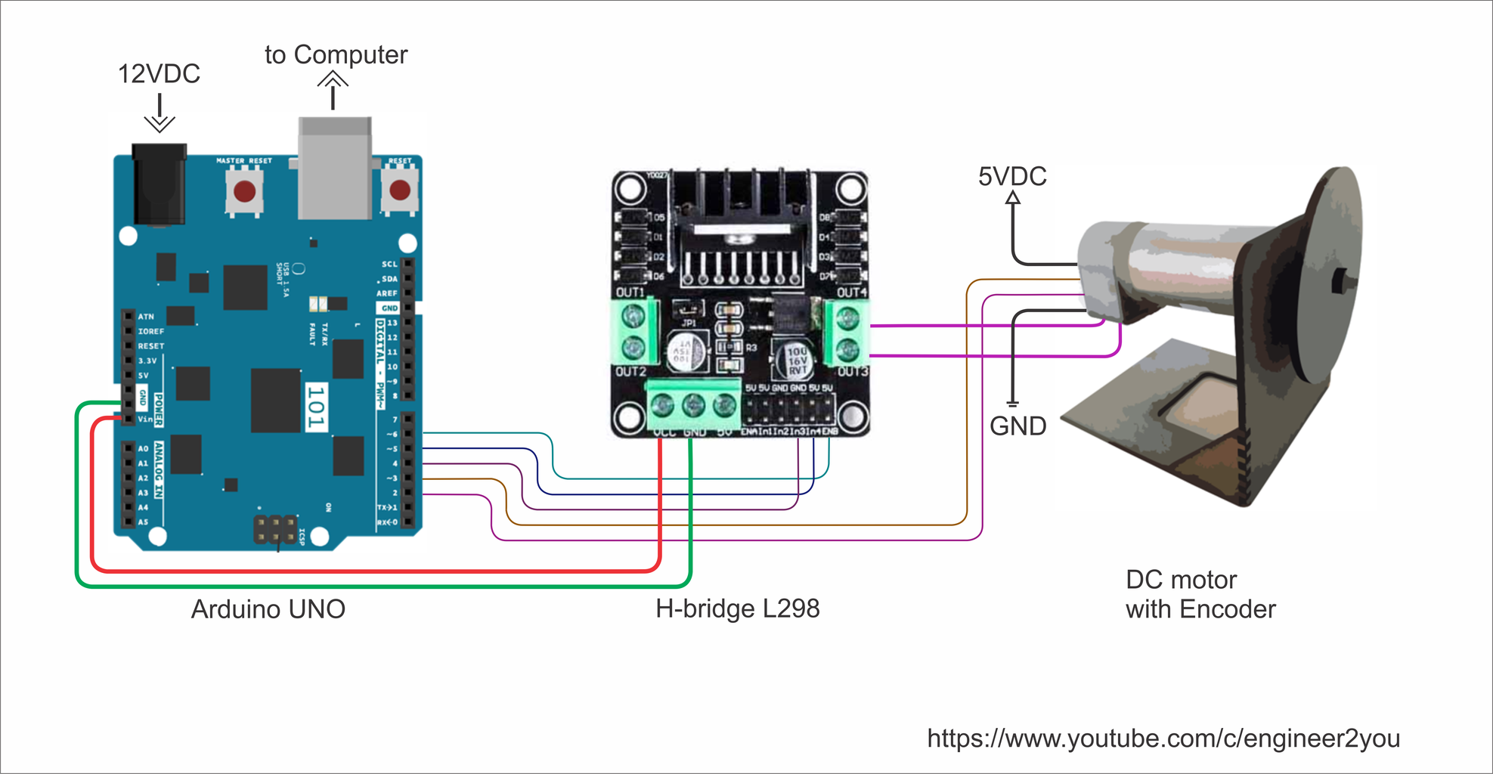
Model of the DC motor speed controller
For a DC motor:
V=Eb+IaRa

Slide 4

PROGRAM
import numpy as np
import matplotlib.pyplot as plt
from scipy import signal
# --- DC motor parameters ---
J = 0.01 # kg·m^2
b = 0.1 # N·m·s
K = 0.01 # N·m/A (also V·s/rad)
R = 1.0 # ohm
L = 0.5 # H
# Motor transfer function G(s) = K / (JLs^2 + (JR+Lb)s + (Rb + K^2))
numG = [K]
denG = [J*L, J*R + L*b, R*b + K**2]
# --- PID controller C(s) = Kd s + Kp + Ki/s = (Kd s^2 + Kp s + Ki) / s ---
Kp, Ki, Kd = 100.0, 200.0, 10.0
numC = [Kd, Kp, Ki]
denC = [1.0, 0.0]
# Open loop: OL(s) = C(s)G(s) = N(s)/D(s)
numOL = np.convolve(numC, numG)
denOL = np.convolve(denC, denG)
# Closed loop with unity feedback: T(s) = OL / (1 + OL) = N / (D + N)
numCL = numOL
denCL = np.polyadd(denOL, numOL)
# LTI system and step response
sys = signal.TransferFunction(numCL, denCL)
t = np.linspace(0, 2.0, 1000)
t, y = signal.step(sys, T=t)
plt.figure(figsize=(10, 6))
plt.plot(t, y, label="Speed (rad/s) for 1-rad/s step")
plt.xlabel("Time (s)")
plt.ylabel("Speed (rad/s)")
plt.title("DC Motor Speed Control with PID (SciPy only)")
plt.grid(True)
plt.legend()
plt.show()

Slide 5
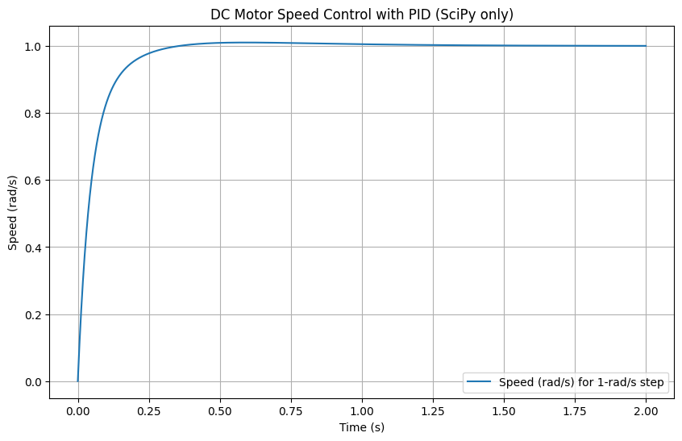
PROGRAM import numpy as np import matplotlib.pyplot as plt from scipy import signal # --- DC motor parameters --- J = 0.01 # kg·m^2 b = 0.1 # N·m·s K = 0.01 # N·m/A (also V·s/rad) R = 1.0 # ohm L = 0.5 # H # Motor transfer function G(s) = K / (JLs^2 + (JR+Lb)s + (Rb + K^2)) numG = [K] denG = [J*L, J*R + L*b, R*b + K**2] # --- PID controller C(s) = Kd s + Kp + Ki/s = (Kd s^2 + Kp s + Ki) / s --- Kp, Ki, Kd = 100.0, 200.0, 10.0 numC = [Kd, Kp, Ki] denC = [1.0, 0.0] # Open loop: OL(s) = C(s)G(s) = N(s)/D(s) numOL = np.convolve(numC, numG) denOL = np.convolve(denC, denG) # Closed loop with unity feedback: T(s) = OL / (1 + OL) = N / (D + N) numCL = numOL denCL = np.polyadd(denOL, numOL) # LTI system and step response sys = signal.TransferFunction(numCL, denCL) t = np.linspace(0, 2.0, 1000) t, y = signal.step(sys, T=t) plt.figure(figsize=(10, 6)) plt.plot(t, y, label="Speed (rad/s) for 1-rad/s step") plt.xlabel("Time (s)") plt.ylabel("Speed (rad/s)") plt.title("DC Motor Speed Control with PID (SciPy only)") plt.grid(True) plt.legend() plt.show()

Slide 6
Conclusion:
A speed of a DC motor is directly proportional to back emf induced in its armature and inversely proportional to to the magnetic flux penetrating its armature winding.

